Slide 1
Chapter 2 –Tools for Java Development

Slide 2
Tools for Working with Programming Languages
Design Tool
GUI Tool
Compiler
Code editor
Database
Language support for code editor
Source code
Source code repository

Slide 3
Variety of Tools for OOD and Java
OOD Tool
GUI Tool
JDK – Compiler
Code editor
Database
Java Support for Code Editor
Source code
Source code repository

Slide 4
Code Editor
There are a variety of commercial and free source code editors available on the market:
Visual Studio Code (free)
Eclipse (free)
Microsoft Visual Studio (partially free)
Microsoft Visual Studio Community (free)
Intellij (commercial)
Replit (web-based, subscription)
Most Code Editors can support different programming languages subject to their settings. However, some are language specific.

Slide 5

IDE and JDK
Java can be available for runtime and for development purposes:
Runtime for running ready Java programs
Development purpose means creating new or modifying existing Java programs.
JDK - Java Developer Kit provides compiler and all basic necessary libraries for Java developers. The JDK is the development platform for building Java applications.
IDE - Integrated Development Environment is a software application that provides comprehensive facilities for software development. An IDE normally consists of at least a source-code editor, build automation tools, and a debugger.

Slide 6
Java Archetypes and Libraries
An archetype is a project templating toolkit.
An archetype is defined as an original pattern or model from which all other things of the same kind are made.
Typical archetypes:
Maven (the major one)
Gradle
Spring boot
Quarkus
Archetype will help authors create Maven project templates for users and provides users with the means to generate parameterized versions of those project templates.

Slide 7

Databases
Databases are used for storing, maintaining and accessing any sort of data.
They collect required information on the subject matter, people, places, things.
Schemas
Hierarchical databases
Network databases
Relational databases
Object-oriented databases
NoSQL databases
Storage
Cloud Database
Centralized Database
Distributed Database

Slide 8
Source Code Repositories and Version Control
In software engineering, a version control system is used to keep track of versions of a set of files, usually to allow multiple developers to collaborate on a project.
The repository keeps track of the files in the project, which is represented as a graph.
Examples of cloud-based source code repositories and version control systems:
Git/GitHUB
SourceForge
Assembla
eBook

Slide 9
UML -- Unified Modeling Language (1/3)
Unified Modeling Language (UML) is a graphical language used to model and document software systems, while OOD is a design methodology that emphasizes the use of objects, inheritance, encapsulation, and polymorphism to build modular and reusable software systems.
It was developed in 1990s as an amalgamation of several techniques, prominently OOAD technique by Grady Booch, OMT (Object Modeling Technique) by James Rumbaugh, and OOSE (Object Oriented Software Engineering) by Ivar Jacobson. UML attempted to standardize semantic models, syntactic notations, and diagrams of OOAD.

Slide 10
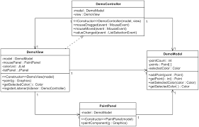
UML -- Unified Modeling Language (2/3)
Systems and Models in UML
System − A set of elements organized to achieve certain objectives form a system. Systems are often divided into subsystems and described by a set of models.
Model − Model is a simplified, complete, and consistent abstraction of a system, created for better understanding of the system.
View − A view is a projection of a system’s model from a specific perspective.

Slide 11
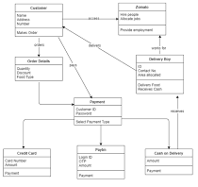
UML -- Unified Modeling Language (3/3)
The Conceptual Model of UML encompasses three major elements:
Basic building blocks
Rules
Common mechanisms
The three building blocks of UML are:
Things
Relationships
Diagrams

Slide 12
Creating our Java IDE for this Course
Repository GitHub we will discuss later in this lecture.
OOD tool, GUI tool, and databases we will discuss later in this course.
JDK – Java Compiler (Oracle)
Visual Studio Code
Java support for Visual Studio Code
OOD Tool
GUI Tool
JDK – Compiler
Code editor “Visual Studio Code”
Database
Java support for code Editor
Source code
Source code repository “GitHub”

Slide 13
Installing your Java IDE – Integrated Development Environment

Slide 14
Installing and Configuring your JDK and Editor
First of all, you should install and configure three major components of your development environment
JDK Compiler
Code editor (Visual Studio Code)
JDK – Compiler
Code editor “Visual Studio Code”
Java Support for Code Editor
Source code
Java support for Visual Studio Code (that includes appropriate libraries and archetypes
JDK is installed as a separate module from Oracle.
We will use Visual Studio Code (VSC) as a code editor. It is a generic empty shell of the code editor that should be configured to Java. It can be configured to Python and many other programming languages.
Java support for VSC comes as a separate package that links the code editor with the JDK-compiler. It includes the appropriate libraries and archetypes.

Slide 15
Installing your JDK – Java Development Kit

Slide 16
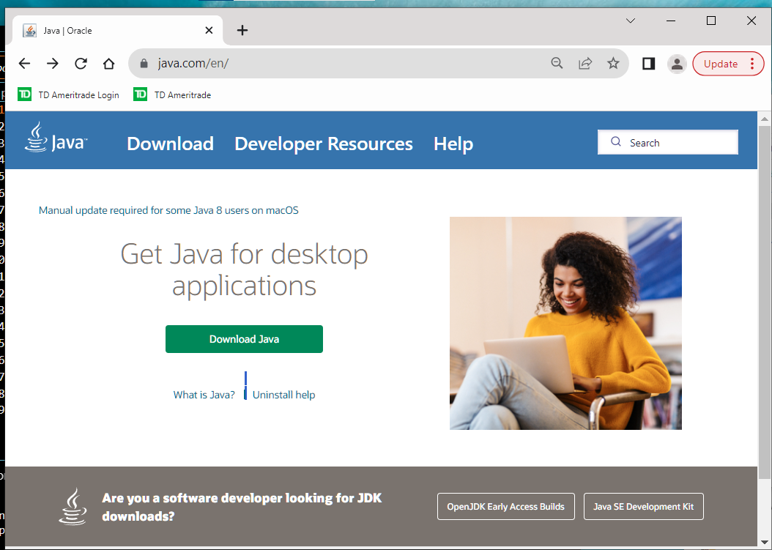
Installing JDK (Java Development Kit)
Go to java.com
Click on “Java SE Development Kit” in the bottom-right part of the web page

Slide 17
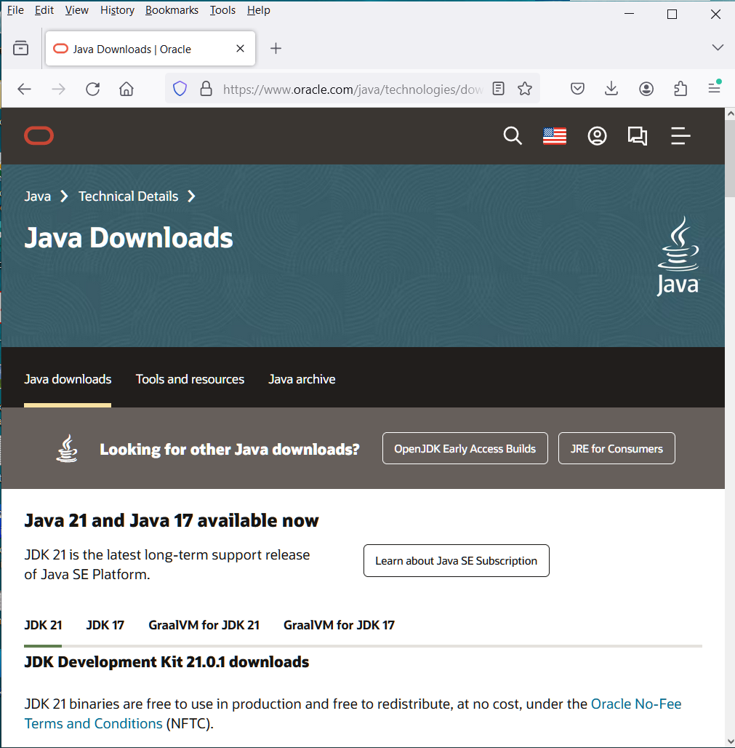
Installing JDK (Java Development Kit)
On this page, scroll down to “JDK Development Kit 21.0.1 downloads”
Java version 21 was released on September 19, 2023.

Slide 18
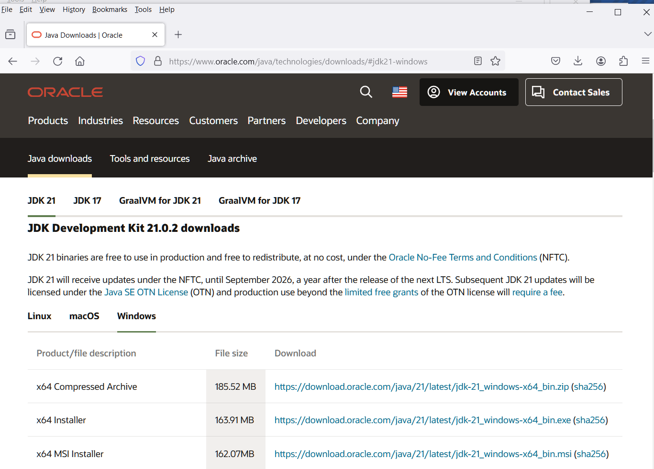
Installing JDK (Java Development Kit)
On this page, scroll down to “JDK Development Kit 21.0.2 downloads”
Select one of the options for your operating system:
Linus,
macOS,
Windows
Suppose you’ve chosen “Windows”,
then select “x64 Installer”

Slide 19
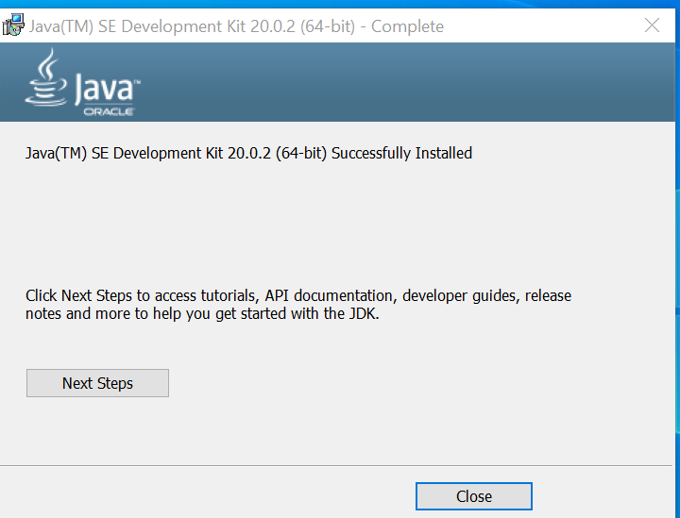
Installing JDK (Java Development Kit)
A popup window comes up.
Close it.
The installation is complete.
Next, you have to configure environment variables on your computer to provide global pass to the installed JDK (see the next slide).

Slide 20
Configuring the Environment Variables on your Computer after Installation of JDK
The JDK is already installed on your computer
Now, you have to tell the programs on your computer where it installed to make sure that the programs running Java know where it is located.
This information is provided by global variables which contain the path pointing to the folder that contains JDK

Slide 21

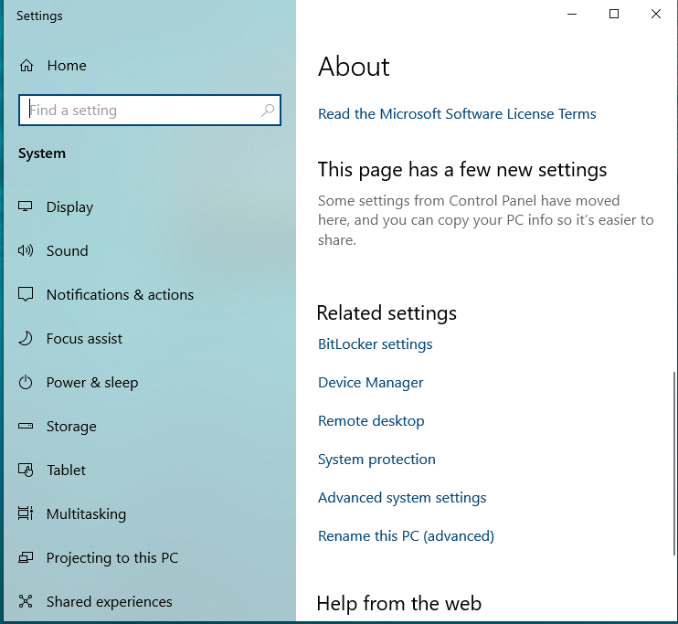
Setting up Global Path - Instructions for PC (1/3)
Right click on the Windows home
Select “System”
Then select “Advanced System Settings”

Slide 22
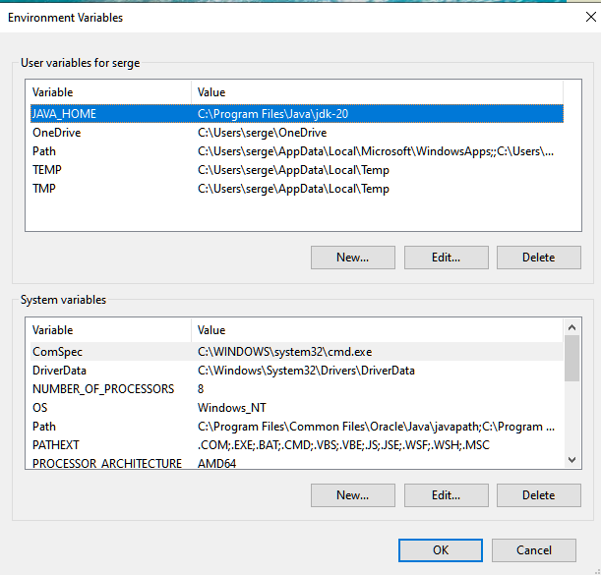
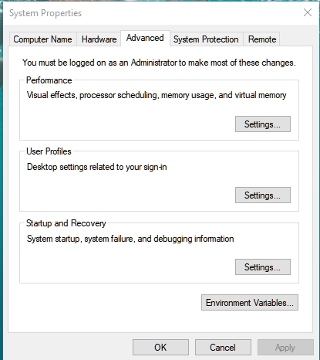
Setting up Global Path - Instructions for PC (2/3)
Press on “Environment Variables”
If you want to set up global path for the current user, then click “New” here.
If you want to set up global path variable for all users, then click “New” here.

Slide 23
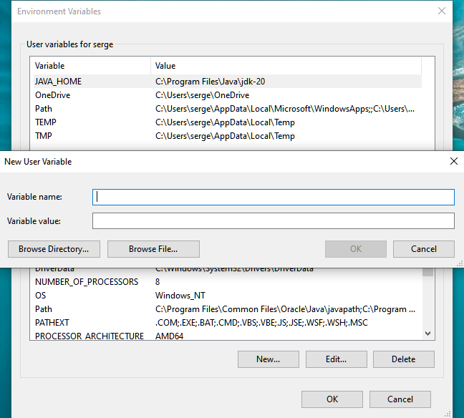
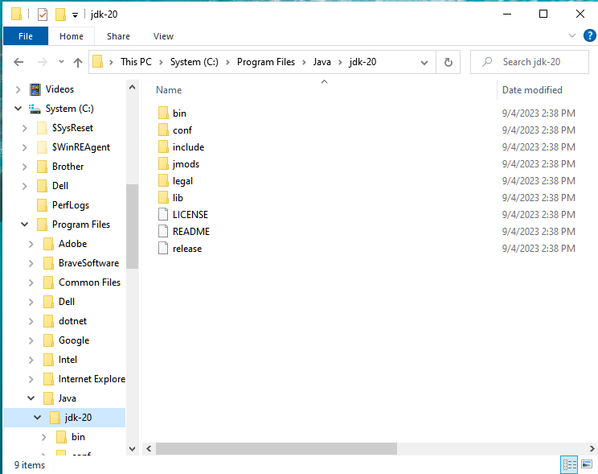
Setting up Global Path - Instructions for PC (3/3)
Write “JAVA_HOME” (without the quotation sign)
Navigate File Explorer to -> C:\Program Files\Java\jdk-20
Right click on the empty space in the path section and copy address.
Paste the copied address here and press “OK”

Slide 24
Your JDK is Now Installed
Let’s Install the Code Editor (Visual Studio Code)

Slide 25
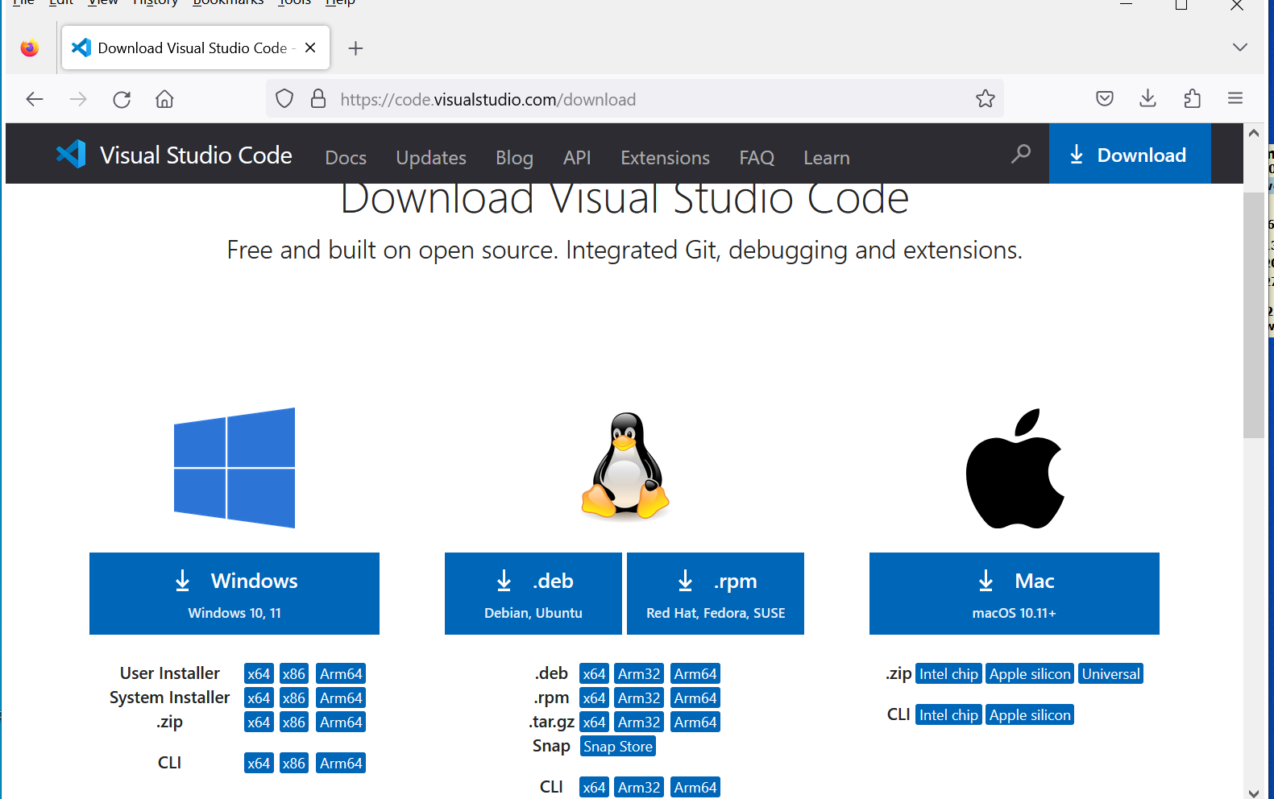
Installing Visual Studio Code
Go to https://code.visualstudio.com/download
Choose your operating system:
Windows
Linux
macOS
The installation file will be downloaded.
Run the installation file by clicking on it.

Slide 26
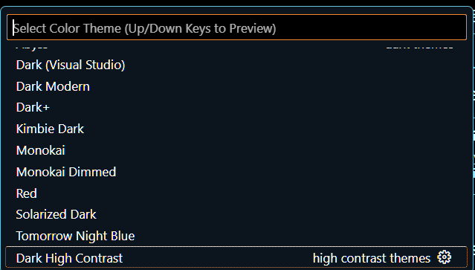
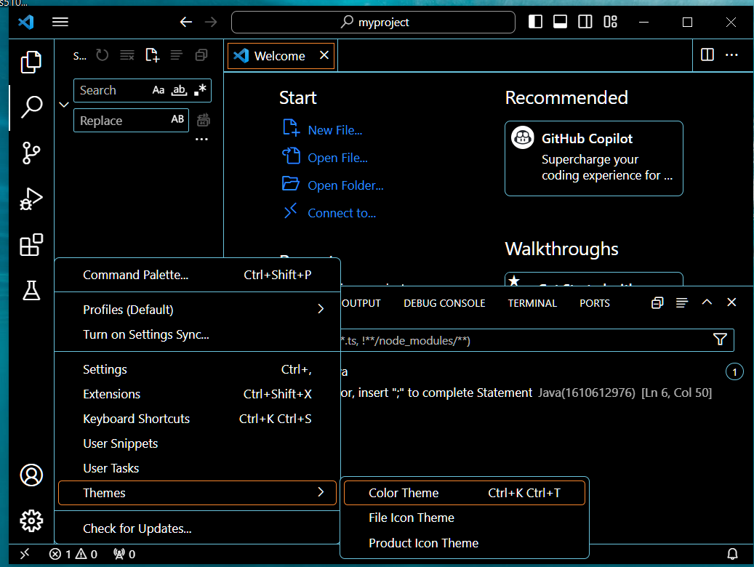
Setting Color themes in VSCode (1/2)
Settings -> Themes -> Color Theme
Choose a color theme from the box that comes up
Color Theme
Keyboard shortcut Ctrl+K Ctrl+T
to display the color theme picker.
Themes
Click here on settings

Slide 27
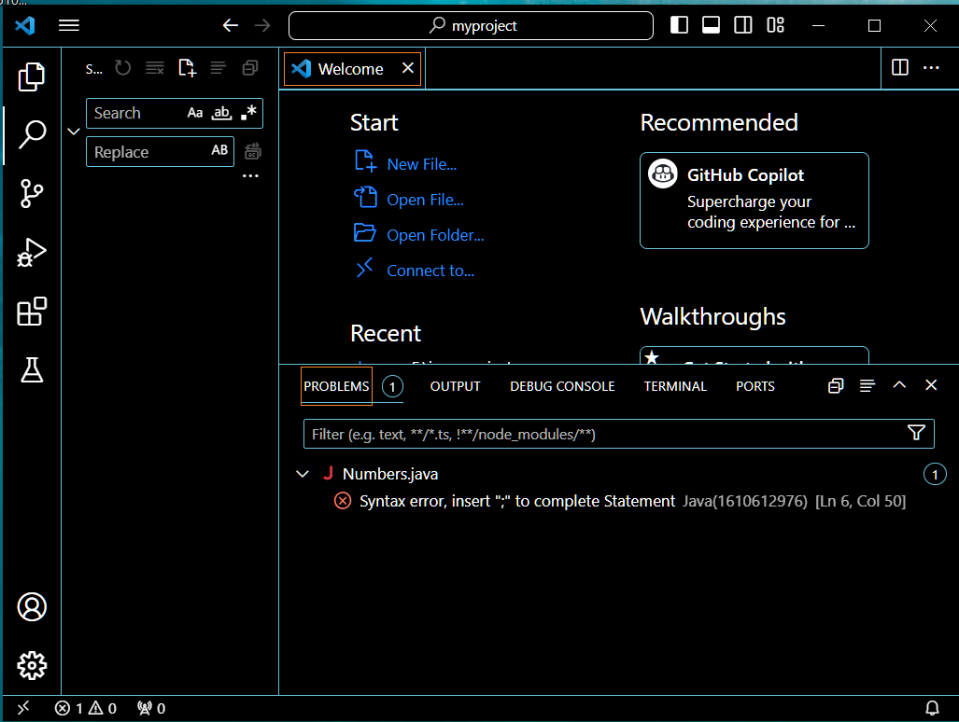
Visual Studio Code UI
Editor groups pane
Active bar menu
Panel and terminal pane
Side bar
Status bar

Slide 28
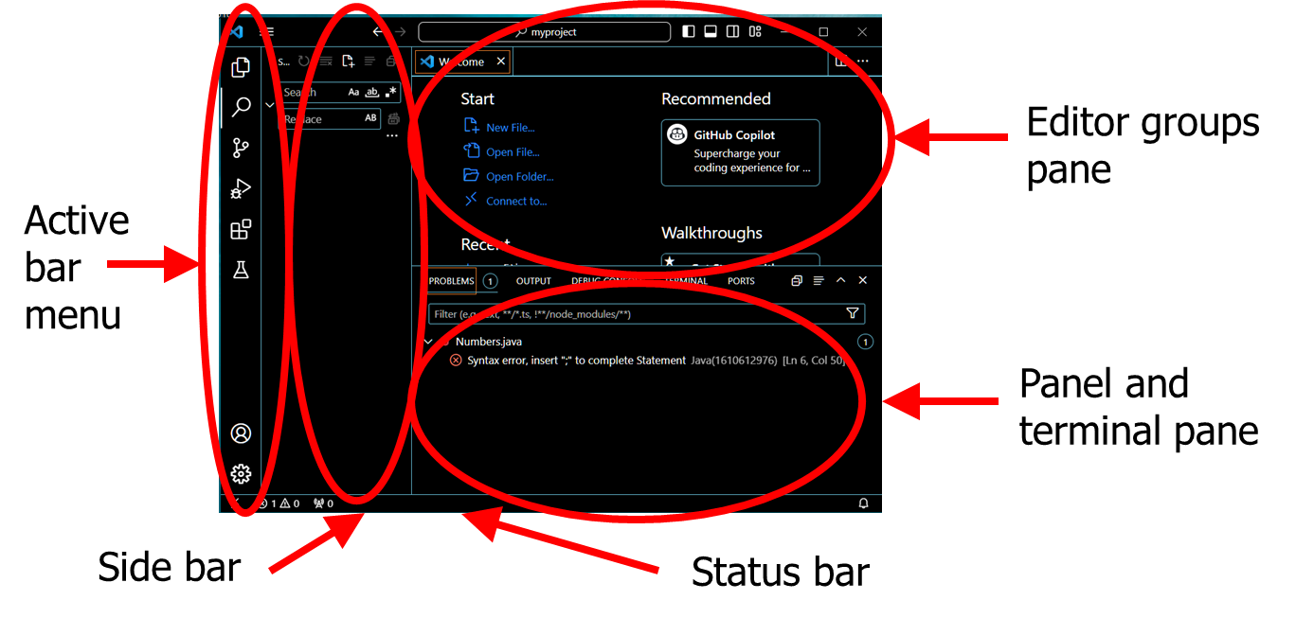
Visual Studio Code UI (Basic Layout)
VS Code comes with an intuitive layout. The UI is divided into five main areas:
Editor - The main area to edit your files. You can open as many editors as you like side by side vertically and horizontally.
Primary Side Bar - Contains different views like the Explorer to assist you while working on your project.
Status Bar - Information about the opened project and the files you edit.
Activity Bar - Located on the far left-hand side, this lets you switch between views and gives you additional context-specific indicators, like the number of outgoing changes when Git is enabled.
Panel - An additional space for views below the editor region. By default, it houses output, debug information, errors and warnings, and an integrated terminal. Panel can also be moved to the left or right for more vertical space.
Tip: A Secondary Side Bar is also available to display views opposite the Primary Side Bar. You can show it with Ctrl+Alt+B.

Slide 29
Installing Java Support for Visual Studio Code

Slide 30
Installing Java Support for the Code Editor
Search for “VSCode Java Support” on Google or just go directly to https://code.visualstudio.com/docs/languages/java
Scroll down the web page to find buttons
“Install the Coding Pack for Java – Windows”
“Install the Coding Pack for Java – macOS”
Click on the appropriate button according to your operating system.
Now, your Java development environment is set up.
You can run your first Java program. See the next slide.

Slide 31
Your basic Java IDE is now installed and ready to go
Yet to be used for a complete IDE
Version control system and repository
GUI tool
Database connection
OOD tools

Slide 32
Creating and Running your First Java Program

Slide 33
Creating and Running your First Java Program
Create a folder for your Java program files.
Link this folder to the VSCode.
Create a new program file.
Write your first program “Hello World”
Run you “Hello World” program

Slide 34
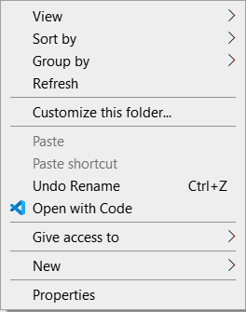
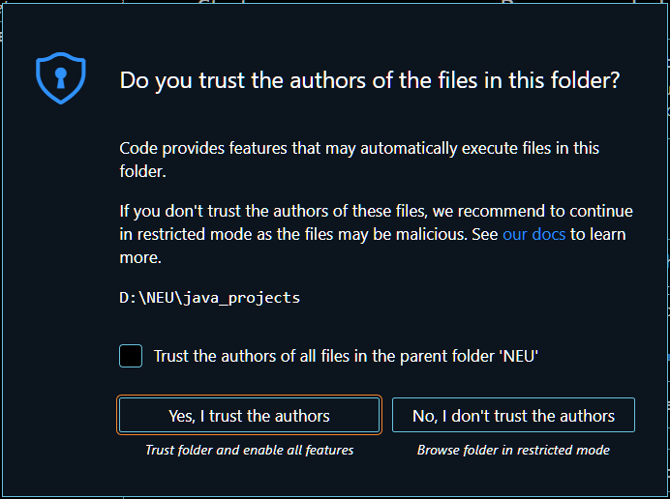
Setting up a Local Folder for your Program
Create a folder on the hard drive of your computer where VSCode will store files of your Java program. Suppose, the folder name is “java_projects”.
Open the folder in “File Explorer”
On the mouse right click, select “Open with code” option.
The computer automatically switches to VSCode and shows a popup window with a question “Do you trust the author of the files in this folder?”
Press button “Yes, I trust the authors” if you trust.
Your folder is now linked to the VSCode.

Slide 35
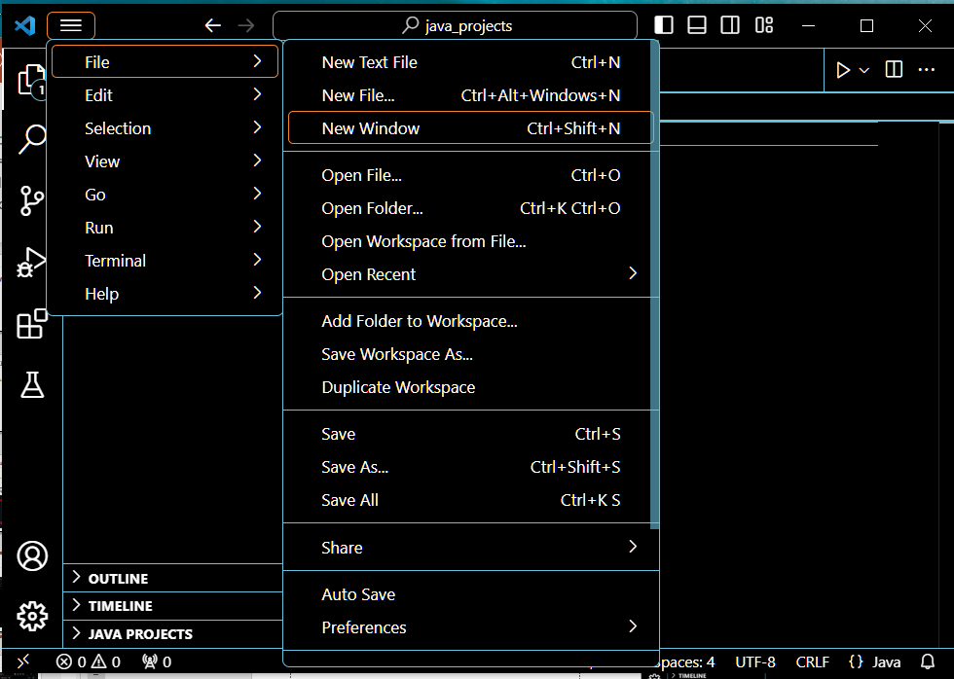
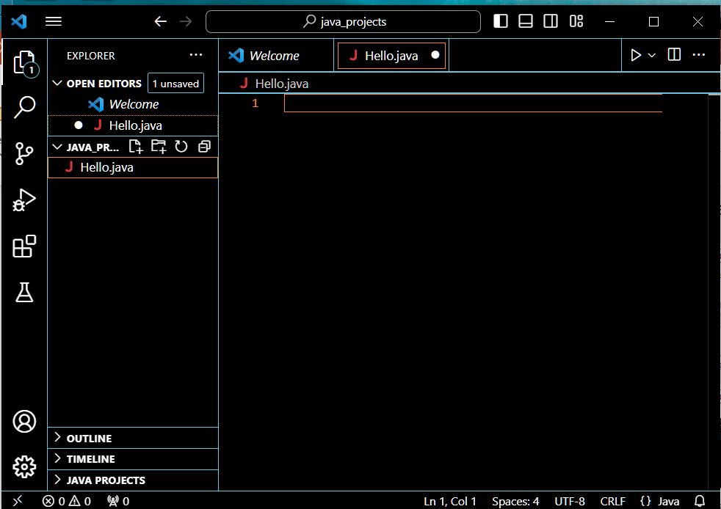
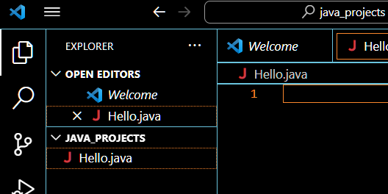
Create a New Java File
Open a new file by
selecting from top menu -> “File” -> “New File” or by
clicking here on “New File”
Enter here the file name with java extension ”Hello.java”

Slide 36
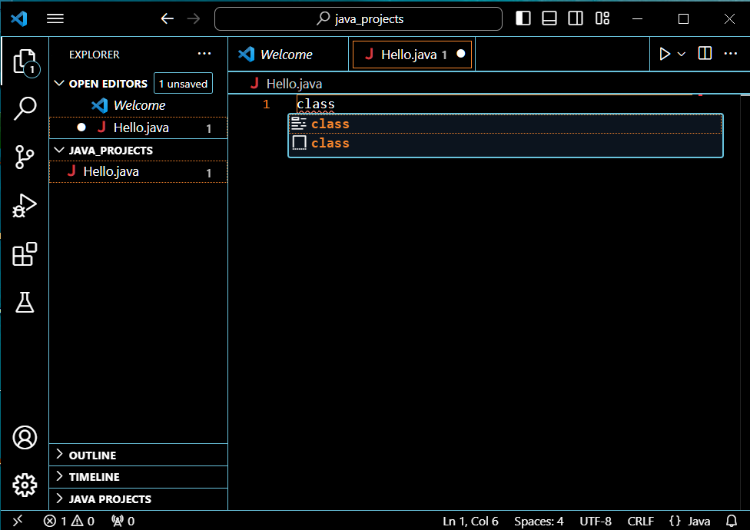
Class Definition
Type here “class”
A popup window appears with a hint “class”. Click on it.
Class “Hello” definition will be automatically generated.
The class name is always the same as the file name.

Slide 37
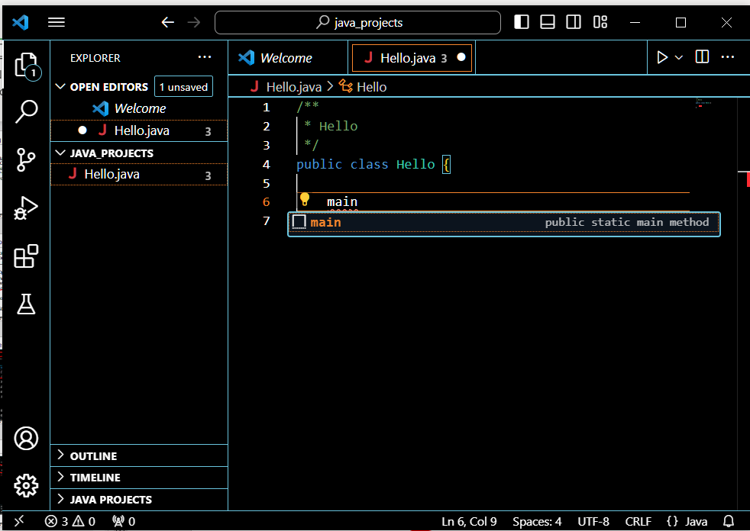
Method Definition
Type here “main”
A popup window appears with a hint “main”. Click on it.
Method (function) “main” will be automatically generated.

Slide 38
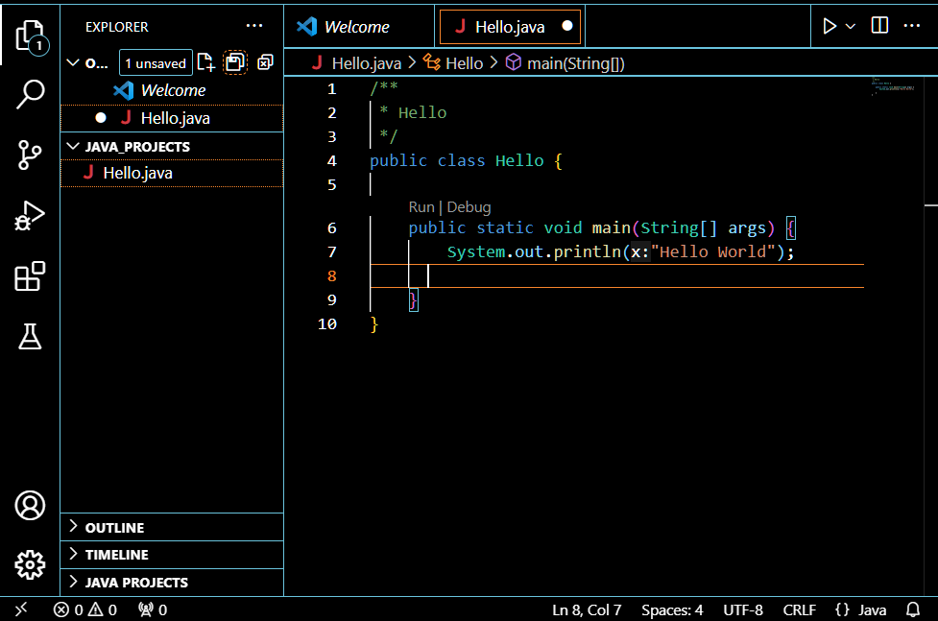
Print Statement “Hello World” and Run
Type here -- System.out.println(“Hello World”);
This is your first java statement in your first Java program.
All statements in Java are ending with semicolon “;”
Click here to run your program.

Slide 39
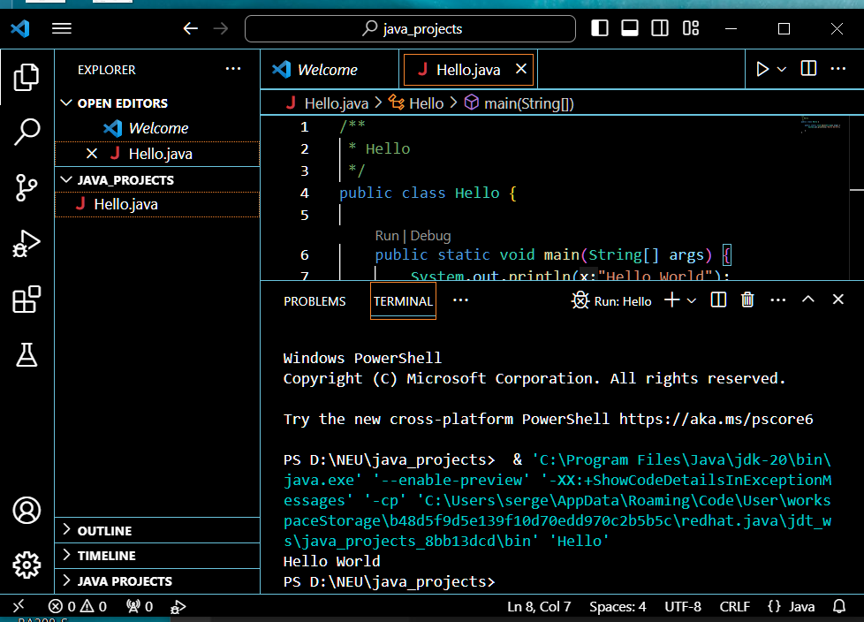
Running your Program
This is your program file name.
Thus is your program source code.
This is your program output shown in the VSCode terminal.
Congratulations on your first Java program!

Slide 40
Hello World Program Source Code
// Hello world!
public class Hello {
public static void main( String[] args ) {
System.out.println( "Hello World!" );
}
}

Slide 41
Hello World Program Source Code
This is the major program statement of your first program
// Hello world!
public class Hello {
public static void main( String[] args ) {
System.out.println( "Hello World!" );
}
}

Slide 42
Setting GitHub - your Version Control and Repository System
OOD Tool
GUI Tool
JDK – Compiler
Code editor “Visual Studio Code”
Database
Java support for code Editor
Source code
Source code repository “GitHub”

Slide 43

Installing GitHub – a Version Control
Git is a popular fee of charge version control system.
GitHub is its cloud-based code hosting platform for version control, repository, and collaboration.
It lets you and others work together on projects from anywhere.
With GitHub, you will be able to:
Create and use a repository
Start and manage a new branch
Make changes to a file and push them to GitHub as commits
Open and merge a pull request

Slide 44
Creating your GitHub Online Account
GitHub is available online at https://github.com
To create a GitHub account got o https://github.com/join
Choose your username
Enter your email address
Create your password

Slide 45
Creating a Repository (1/2)
A repository is usually used to organize a single project.
Repositories can contain folders and files, images, videos, spreadsheets, and data sets -- anything your project needs.
Often, repositories include a README file, a file with information about your project. README files are written in the plain text Markdown language.
You can use this cheat sheet to get started with Markdown syntax. GitHub lets you add a README file at the same time you create your new repository.
GitHub also offers other common options such as a license file, but you do not have to select any of them now.
Your repository can be a place where you store your source code, ideas, resources, or even share and discuss things with others.

Slide 46
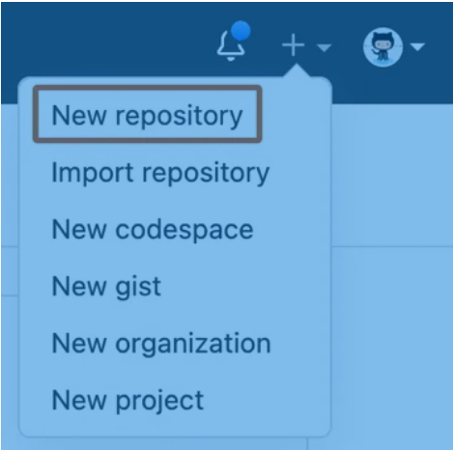
Creating a Repository (2/2)
To create a new repository, click on the “+” sign in the upper-right corner of any page and use the drop-down menu and select “New repository”.
In the "Repository name" box, type the name of your new repository, say, “myproject”.
In the "Description" box, type a short description.
Select whether your repository will be “Public” or “Private”.
Public repositories are accessible to everyone on the internet.
Private repositories are only accessible to you, people you explicitly share access with, and, for organization repositories, certain organization members.
Internal repositories are accessible to all enterprise members.
Select “Add a README file”.
Click “Create repository”.

Slide 47
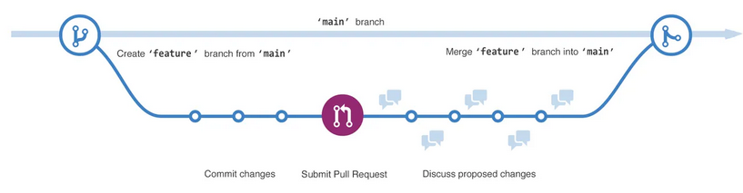
Branching (1/2)
Branching lets you have different versions of repository at one time.
The main branch
A new branch called feature
The journey that feature takes before it merged into main

Slide 48
Branching (2/2)
By default, your repository has one branch named main that is considered to be the definitive branch.
You can create additional branches off the main branch in your repository.
When you create a branch off the main branch, you're making a copy, or snapshot, of main as it was at that point in time.
If someone else made changes to the main branch while you were working on your branch, you could pull in those updates.

Slide 49
Why is Branching Needed?
You can use branches to have different versions of a project at one time.
This is helpful when you want to add new features to a project without changing the main source of code.
The work done on different branches will not show up on the main branch until you merge it, which we will cover later in this guide.
You can use branches to experiment and make edits before committing them back to main.
With GitHub, developers, writers, and designers use branches for keeping bug fixes and feature work separate from our main (production) branch.
When a change is ready, they merge their branch into main.

Slide 50
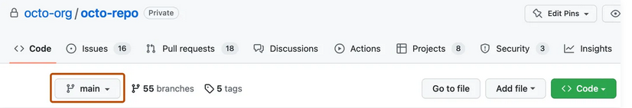
Creating a Branch (1/2)
Click the Code tab of your “myproject” repository.
Above the file list, click the dropdown menu that says main.

Slide 51
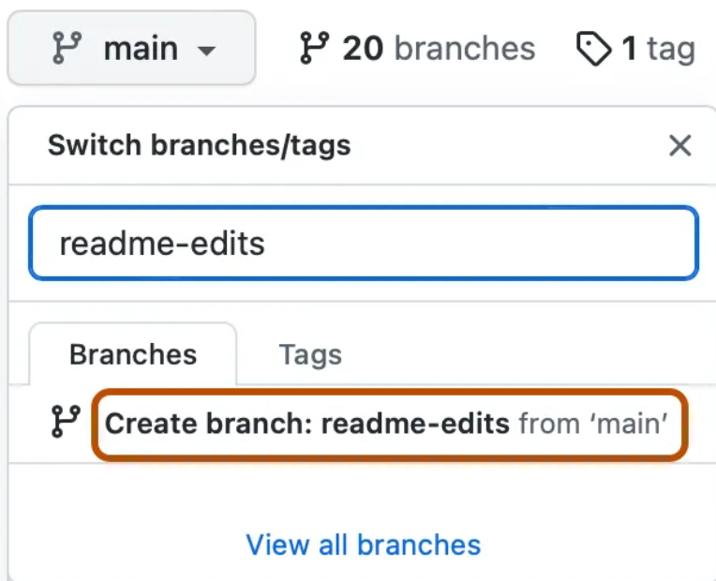
Creating a Branch (2/2)
Type a branch name, for example, “myproject-edits”, into the text box.
Click “Create branch: myproject-edits from main”.
myproject-edit
myproject-edit from main
Now, you have two branches, “main” and “myproject-edits”.
Right now, they look exactly the same.
Next, you'll add changes to the new branch.

Slide 52
Making and Committing Changes (1/2)
When you created a new branch in the previous step, GitHub brought you to the code page for your new “myproject-edits” branch, which is a copy of main.
You can make and save changes to the files in your repository. On GitHub, saved changes are called commits.
Each commit has an associated commit message, which is a description explaining why a particular change was made.
Commit messages capture the history of your changes so that other contributors can understand what you’ve done and why.

Slide 53

Making and Committing Changes (1/2)
Perform the following steps to commit changes:
Under the “myproject-edits” branch you created, click the README.md file.
To edit the file, click
In the editor, write a bit about yourself. Try using different Markdown elements.
Click Commit changes....
In the "Propose changes" box, write a commit message that describes your changes.
Click “Propose changes”.
These changes will be made only to the README file on your “myproject-edits” branch, so now this branch contains content that's different from main.

Slide 54
Opening a Pull Request (1/4)
Pull requests are the heart of collaboration on GitHub.
When you open a pull request, you're proposing your changes and requesting that someone review and pull in your contribution and merge them into their branch.
Pull requests show diffs, or differences, of the content from both branches.
The changes, additions, and subtractions are shown in different colors.
As soon as you make a commit, you can open a pull request and start a discussion, even before the code is finished.
By using GitHub's @mention feature in your pull request message, you can ask for feedback from specific people or teams, whether they're down the hall or 10 time zones away.

Slide 55
Opening a Pull Request (2/4)
You can even open pull requests in your own repository and merge them yourself. It's a great way to learn the GitHub flow before working on larger projects.
Click the Pull requests tab of your hello-world repository.
Click New pull request
In the Example Comparisons box, select the branch you made, readme-edits, to compare with main (the original).

Slide 56
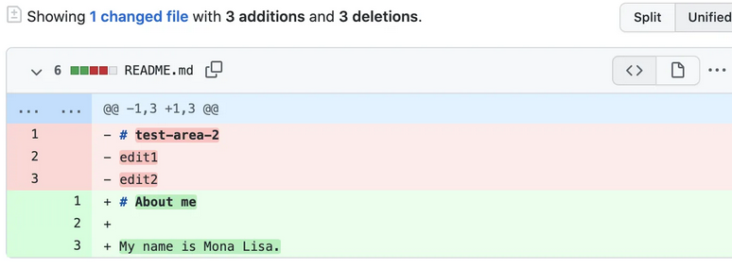
Opening a Pull Request (3/4)
Look over your changes in the diffs on the Compare page, make sure they're what you want to submit.

Slide 57
Opening a Pull Request (4/4)
Click “Create pull request”.
Give your pull request a title and write a brief description of your changes. You can include emojis and drag and drop images and gifs.
Optionally, to the right of your title and description, click the next to Reviewers, Assignees, Labels, Projects, or Milestone to add any of these options to your pull request. You do not need to add any yet, but these options offer different ways to collaborate using pull requests. For more information, see "About pull requests."
Click Create pull request.
Your collaborators can now review your edits and make suggestions.

Slide 58
Merging Your Pull Request (1/2)
In this final step, you will merge your readme-edits branch into the main branch. After you merge your pull request, the changes on your “myproject-edits” branch will be incorporated into main.
Sometimes, a pull request may introduce changes to code that conflict with the existing code on main.
If there are any conflicts, GitHub will alert you about the conflicting code and prevent merging until the conflicts are resolved.
You can make a commit that resolves the conflicts or use comments in the pull request to discuss the conflicts with your team members.

Slide 59
Merging Your Pull Request (2/2)
In this walk-through, you should not have any conflicts, so you are ready to merge your branch into the main branch.
At the bottom of the pull request, click Merge pull request to merge the changes into main.
Click Confirm merge. You will receive a message that the request was successfully merged and the request was closed.
Click Delete branch. Now that your pull request is merged and your changes are on main, you can safely delete the “myproject-edits” branch.
If you want to make more changes to your project, you can always create a new branch and repeat this process.

Slide 60
Next Steps
By completing this tutorial, you've learned to create a project and make a pull request on GitHub.
Here's what you accomplished in this tutorial:
Created an open source repository
Started and managed a new branch
Changed a file and committed those changes to GitHub
Opened and merged a pull request
Take a look at your GitHub profile and you'll see your work reflected on your contribution graph.

Slide 61
GitHub as Version Control and Repository System is now set and ready to go.
OOD Tool
GUI Tool
JDK – Compiler
Code editor “Visual Studio Code”
Database
Java support for code Editor
Source code
Source code repository “GitHub”

Slide 62
Chapter 2 –Tools for Java Development

